Slide 1
The Framework for Universal Healthcare Database
A comparison of relational database and no sql database
Meredith Ludlow & Javier Saldaña Jr.

Slide 2
Agenda
The Problem
Previous Studies
Current Examples
Project Objective
Challenges & Regulations

Slide 3
The Problem
You get a database! You get a database! And you get a database!

Slide 4

Isolation Preventing Scale
In USA
6,210 Hospitals (AHA Hospital Statistics, 2019)
70% of which are community hospitals

Slide 5
Isolation Preventing Scale
In USA
6,210 Hospitals (AHA Hospital Statistics, 2019)
70% of which are community hospitals
Under 6,000 insurance companies (Insurance Information Institute, 2019)
5 largest health insurance carriers control 50% market share

Slide 6
Isolation Preventing Scale
In USA
6,210 Hospitals (AHA Hospital Statistics, 2019)
70% of which are community hospitals
Under 6,000 insurance companies (Insurance Information Institute, 2019)
5 largest health insurance carriers control 50% market share
Information Asymmetry
Competitive Advantage or Bad Business?

Slide 7
Isolation Preventing Scale
In USA
6,210 Hospitals (AHA Hospital Statistics, 2019)
70% of which are community hospitals
Under 6,000 insurance companies (Insurance Information Institute, 2019)
5 largest health insurance carriers control 50% market share
Information Asymmetry
Competitive Advantage or Bad Business?

Slide 8
Current Examples
Existing databases that have been consolidated

Slide 9

Consolidated Databases Examples
Malaysia Fingerprint Database
National Crime Information Center (NCIC)
Insurance Services Office (ISO)
University of Texas Health System

Slide 10
Consolidated Databases Examples
Malaysia Fingerprint Database
National Crime Information Center (NCIC)
Insurance Services Office (ISO)
University of Texas Health System

Slide 11
Consolidated Databases Examples
Malaysia Fingerprint Database
National Crime Information Center (NCIC)
Insurance Services Office (ISO)
University of Texas Health System

Slide 12
Consolidated Databases Examples
Malaysia Fingerprint Database
National Crime Information Center (NCIC)
Insurance Services Office (ISO)
University of Texas Health System

Slide 13
Project Objective

Slide 14
Objectives
Theorize what would be the best way to construct a universal healthcare database.
What kind of information would be included?
What structure would work best?
Who would have access to the database?
What challenges would we face in creating this database?

Slide 15
Objectives
Theorize what would be the best way to construct a universal healthcare database.
What kind of information would be included?
What structure would work best?
Who would have access to the database?
What challenges would we face in creating this database?

Slide 16
Relational v. No sqL
Two approaches with one goal in mind… consolidate!

Slide 17

What is a Relational database?
Data is organized into tables or relations.
Each relation has multiple attributes.
Each data entry is identified by a primary key.
Relationships are preserved through use of foreign keys.

Slide 18
What is a Relational database?
Data is organized into tables or relations.
Each relation has multiple attributes.
Each data entry is identified by a primary key.
Relationships are preserved through use of foreign keys.

Slide 19
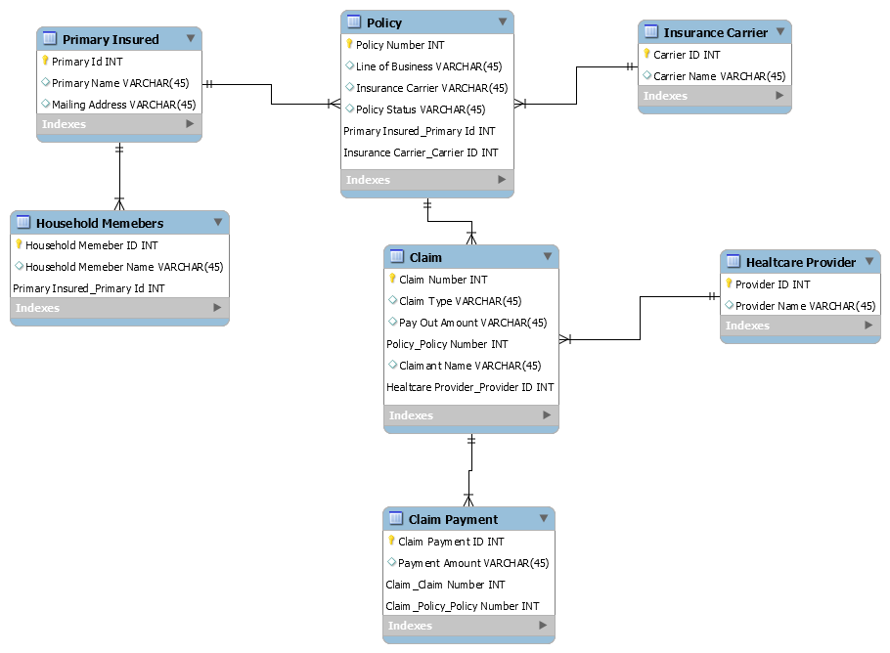
Structure of a Universal Healthcare Database with a Relational Model.

Slide 20


Slide 21
Pros of a Relational Database
Little data redundancy, which leads to data consistency.

Slide 22
Pros of a Relational Database
Little data redundancy, which leads to data consistency.
Relationships are easily defined.

Slide 23
Pros of a Relational Database
Little data redundancy, which leads to data consistency.
Relationships are easily defined.
Uses SQL, good at extracting data.

Slide 24
Pros of a Relational Database
Little data redundancy, which leads to data consistency.
Relationships are easily defined.
Uses SQL, good at extracting data.
Handles large amounts of transactions well.

Slide 25
Cons of a relational model
Schema must be known before hand. Doesn’t have good scalability.

Slide 26
Cons of a relational model
Schema must be known before hand. Doesn’t have good scalability.
Doesn’t handle unstructured or semi-structured data well.

Slide 27
Cons of a relational model
Schema must be known before hand. Doesn’t have good scalability.
Doesn’t handle unstructured or semi-structured data well.
Privacy concerns.

Slide 28
No SQL database

Slide 29






Applications of No SQL database
Multimedia
E-mail
Mobile
Commerce
Social Networks
Gaming

Slide 30

Types of No sql database
What is a column Store no sql database?
Column Family
Stored in columns instead of rows
Read/write in columns
Faster searching

Slide 31
Types of No sql database
Key Value
What is a key value no sql database?
Value assigned unique key
Use key + bucket for efficient queries
Uses cache for quick recall

Slide 32

Types of No sql database
What is a document no sql database?
Document
Similar to key design
Key = document
Document gives structure but still schema-less
{ }
{ }
{ }
{ }

Slide 33

Types of No sql database
Graph Database
What is a graph no sql database?
Store data in nodes
Nodes & documents given relationships/properties
Relationships replace need to join
{ }
{ }
{ }
{ }
{ }
{ }

Slide 34


Structure of a universal health care database using no sql graph design
End user
Behind–the-scenes
{ }
{ }
{ }
{ }
{ }
{ }
{ }

Slide 35
Structure of a universal health care database using no sql graph design
End user
Behind–the-scenes
{ }
{ }
{ }
{ }
{ }
{ }
{ }

Slide 36
Structure of a universal health care database using no sql graph design
End user
Behind–the-scenes
{ }
{ }
{ }
{ }
{ }
{ }
{ }

Slide 37
Structure of a universal health care database using no sql graph design
End user
Behind–the-scenes
{ }
{ }
{ }
{ }
{ }
{ }
{ }

Slide 38




Structure of a universal health care database using no sql graph design
Node
Closer Look Inside
{ }
Fragmented Data
B
A
C

Slide 39
Structure of a universal health care database using no sql graph design
Node
Closer Look Inside
{ }
Fragmented Data
B
A
C

Slide 40
Structure of a universal health care database using no sql graph design
Node
Closer Look Inside
{ }
Fragmented Data
B
A
C

Slide 41
Structure of a universal health care database using no sql graph design
Node
Closer Look Inside
{ }
Fragmented Data
B
A
C

Slide 42

Advantages v. disadvantages of no sql
advantages
Scalability
Efficiency
Partition Data

Slide 43
Advantages v. disadvantages of no sql
advantages
Scalability
Efficiency
Partition Data

Slide 44

Advantages v. disadvantages of no sql
disadvantages
CAP Theorem
BASE v. ACID
Lack of Structure

Slide 45
Advantages v. disadvantages of no sql
disadvantages
CAP Theorem
BASE v. ACID
Lack of Structure

Slide 46
Privacy Rules and Regulations

Slide 47
Gramm-Leach-Bailey Act
Financial institutions must share their data sharing practices with their customers and must allow them to opt out.
Obligates financial institutions to protect customer data.
Questions of if sending data to universal health care database is protecting it.
Many customers could opt-out.

Slide 48
Gramm-Leach-Bailey Act
Financial institutions must share their data sharing practices with their customers and must allow them to opt out.
Obligates financial institutions to protect customer data.
Questions of if sending data to universal health care database is protecting it.
Many customers could opt-out.

Slide 49
hippa
Health Insurance Profitability and Accountability Act
Title II: Administrative Simplification
Requires health insurance companies to protect patient health information.

Slide 50
hippa
Health Insurance Profitability and Accountability Act
Title II: Administrative Simplification
Requires health insurance companies to protect patient health information.
Specifically, info that makes a patient identifiable
Will data be useful?

Slide 51
Recommended design
relational v. no sql

Slide 52



Recommended Design
Relational database
No sql database
{ }
{ }
{ }
{ }
{ }
{ }

Slide 53


Recommended Design
Relational database
No sql database
{ }
{ }
{ }
{ }
{ }
{ }

Slide 54
Next Steps
Update Data Governance Legislation

Slide 55
Next Steps
Update Data Governance Legislation
Assign/Create lead Federal Agency

Slide 56
Next Steps
Update Data Governance Legislation
Assign/Create lead Federal Agency
Update/Improve Cyber Security

Slide 57
Next Steps
Update Data Governance Legislation
Assign/Create lead Federal Agency
Update/Improve Cyber Security
Design & Build (collaborative effort)

Slide 58
Next Steps
Update Data Governance Legislation
Assign/Create lead Federal Agency
Update/Improve Cyber Security
Design & Build (collaborative effort)
Incremental Roll Out

Slide 59
Thank you
Presented by Meredith Ludlow & Javier Saldaña Jr.

Slide 60
References
(AHA Hospital Statistics, 2019) https://www.ahadataviewer.com/quickreport/
(Insurance Information Institute, 2019) https://www.iii.org/fact-statistic/facts-statistics-industry-overview
http://www.ncsl.org/research/health/collecting-health-data-all-payer-claims-database.aspx
https://www.carriermanagement.com/news/2018/01/15/174599.htm

